Slide 1
Digital Games Design and Development
Pearson BTEC National Diploma in Digital Games Design & Development

Slide 2
Ideal Candidate
An enthusiastic lover of games and digital media. Having completed school with 5 GCSE’s at grade A-C Inc. Math, English and Art (or portfolio) plus two/three other subjects. Their portfolio of work would demonstrate an understanding and ability to research/plan/design/undertake and/or write a media project from conception to conclusion. This student would ideally be targeted at Merit and be looking towards achieving Distinction.
As a self-starter this student would be aware of the opportunities presented by The Studio and would have some previous (self/school taught and explored) project work. The submission of an initial summer project would determine a grouping/base level upon entry and this student would be capable of providing all work.
Outside interests should be around the areas of digital media, computer games, art, exhibitions and reading.

Slide 3
Entry Requirements
5 GCSEs A* - C
Must include:
English
Mathematics
Art or Relevant Subject e.g. Media, Graphics, Product Design etc. (or a strong portfolio)
A suitable reference

Slide 4
Units Covered
Mandatory
Optional
Unit 3 Digital Media Skills
Unit 7 Media Enterprise
Unit 8 Responding to a Commission
Unit 13 Digital Games Production
Unit 32 Concept Art
Unit 34 Game Engines Scripting
Unit 40 3D Modelling
Unit 41 3D Environments
Unit 42 Games Testing
Unit 43 3D Digital Animation

Slide 5
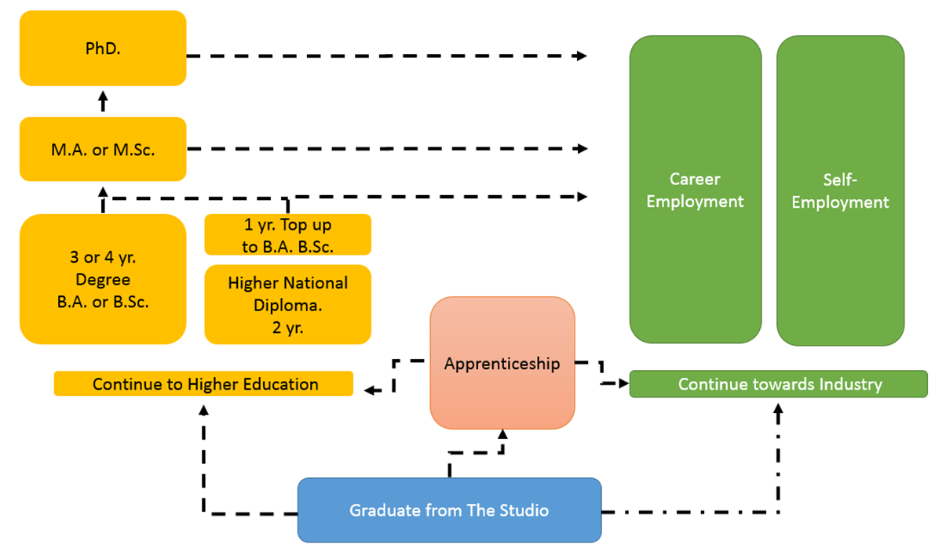
Progression Routes

Slide 6
Typical Jobs and Salaries.
£K p/a

Slide 7
Skills Developed over the course
Ideas Generation
Research Skills
Communication Skills
Drawing
Design
3D Modelling
3D Environment
Computer Game Engine Scripting (Javascript and/or C#)
3D Animation
Project Management
Quality Assurance (Q.A.)
Teamwork
Entrepreneurship
Digital
Creative
Lead
Professional Play
Freelance

Slide 8






Industry Links

Slide 9
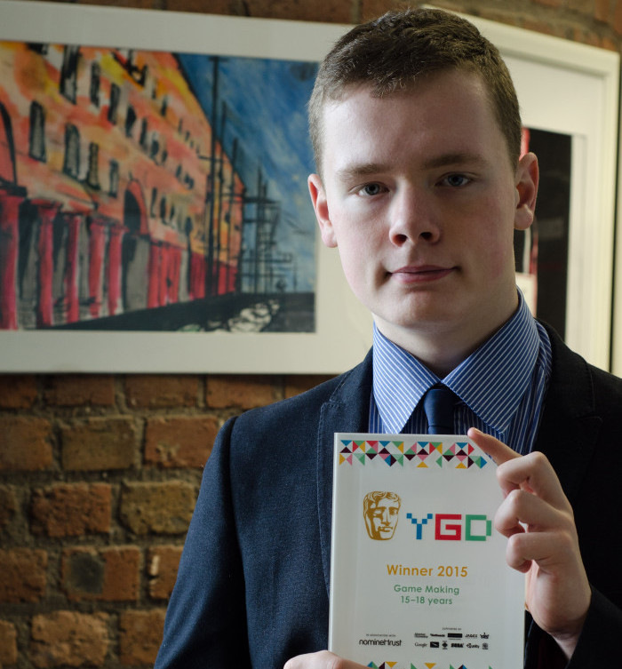
Bonus Features
BAFTA Award – Young Games Designers – Game Maker - Jack Mills.
Work Experience
EGX trip – Euro Gamer
Insomnia – Gaming Event
Developer in Residence – Matt Southern MINT Games/Sony Europe
Sector Skills Champion – Mike Hanson – Psychotic Psoftware

